Slide 1
Calling Convention

Slide 2
Calling conventions describe the interface of called code:
The order in which atomic (scalar) parameters, or individual parts of a complex parameter, are allocated
How parameters are passed (pushed on the stack, placed in registers, or a mix of both)
Which registers the callee must preserve for the caller
How the task of preparing the stack for, and restoring after, a function call is divided between the caller and the callee

Slide 3
Registers
ebp is known as the base pointer or the frame pointer. On entry to your function, you push it (to save the value for the calling function). Then, you copy esp, the stack pointer, into ebp, so that ebp now points to your function's stack frame. At the end of your function, you then pop ebp so that the calling function's value is restored.

Slide 4
Push/Pop %ebp
For some clarification on exactly what is going on - the push instruction puts the value from the specified register (ebp in this case), onto the stack, and decrements the stack pointer by the appropriate amount. The pop operation is the opposite - it increments the stack pointer and takes a value from the stack and puts it in the specified register.

Slide 5
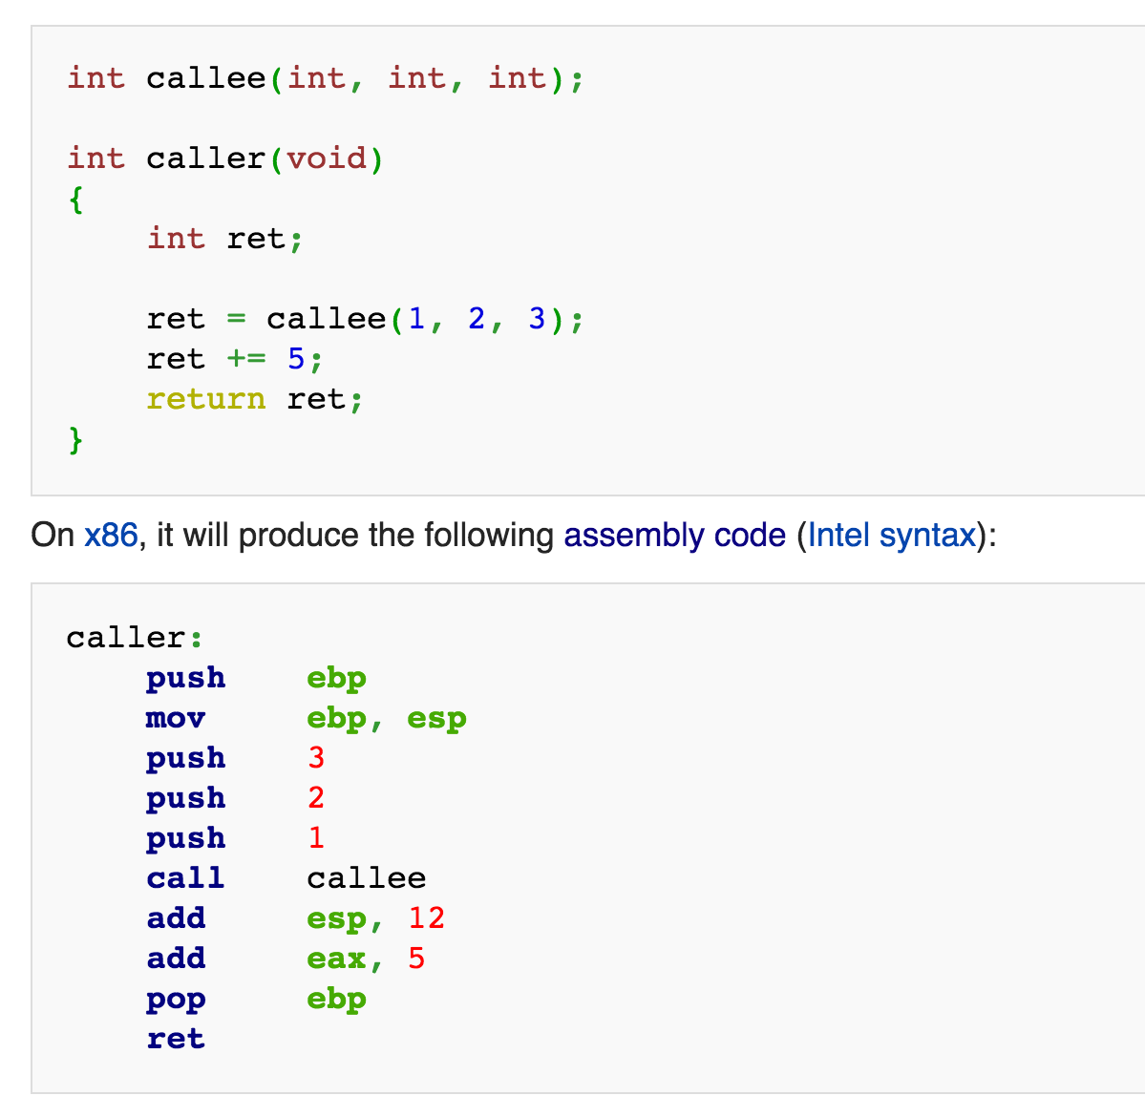

Slide 6
If you want to learn more about assembly syntax, great guide:
https://github.com/majek/baby-steps-in-assembly
Along with associated tutorial: https://idea.popcount.org/2013-07-16-baby-steps-in-x86-assembly/

Slide 7
Passing by Value in C
When a parameter is passed by value, a copy of the parameter is made. Therefore, changes made to the formal parameter by the called function have no effect on the corresponding actual parameter.

Slide 8
Example
void f(int n) {
n++;
}
int main() {
int x = 2;
f(x);
Printf(“%d”, x);
}

Slide 9
In this example, f's parameter is passed by value. Therefore, although f increments its formal parameter n, that has no effect on the actual parameter x. The value output by the program is 2 (not 3).

Slide 10
Note that if a pointer is passed by value, then although the pointer itself is not affected by changes made to the corresponding formal parameter, the object pointed by the pointed can be changed.

Slide 11
void f(int *p) {
*p = 5;
p = NULL;
}
int main() {
int x=2;
int *q = &x;
f(q);
// here, x == 5, but q != NULL
}

Slide 12
In this example, f's parameter is passed by value. Therefore, the assignment p = NULL; in f has no effect on variable q in main (since f was passed a copy of q, not q itself). However, the assignment *p = 5: in f, does change the value pointed to by q. To understand why, consider what happens when the example program runs:

Slide 13
After executing the two statements:
int x=2;
int *q = &x;
memory looks like this:
+---+
x: | 2 | <--+
+---+ |
|
+---+ |
q: | --|----+
+---+

Slide 14
Now function f is called; the value of q (which is the address of x)
is copied into a new location named p:
+---+
x: | 2 | <--+ <--+
+---+ | |
| |
+---+ | |
q: | --|----+ |
+---+ |
|
+---+ |
p: | --|----------+
+---+

Slide 15
Executing the two statements in f:
*p = 5;
p = NULL;
causes the values of x (the thing pointed to by p) and p to be changed:
+---+
x: | 5 | <--+
+---+ |
|
+---+ |
q: | --|----+
+---+
+----+
p: |NULL|
+----+
However, note that q is NOT affected.

Slide 16
Malloc
http://www.inf.udec.cl/~leo/Malloc_tutorial.pdf

Slide 17
Using sbrk to implement malloc
The heap is a continuous (in terme of virtual adresses) space of memory with three bounds:
a starting point
a maximum limit (managed through sys/ressource.h’s functions getrlimit(2)and setrlimit(2))
an end point called the break.
The break marks the end of the mapped memory space, that is, the part of the virtual adress space that has correspondance into real memory.

Slide 18
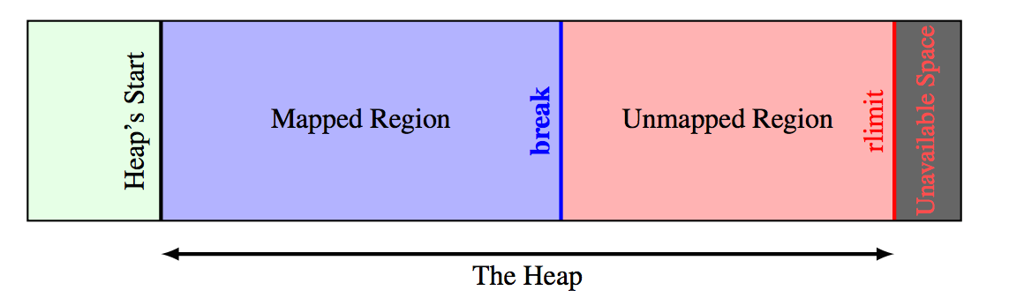

Slide 19
sbrk
sbrk moves the break by the given increment (in bytes.) Depending on system implementation, it returns the previous or the new break adress. On failure, it returns (void *)-1 and set errno.
On some system sbrk accepts negative values (in order to free some mapped memory.)

Slide 20
Malloc Considerations
Think about fragmentation
Efficient use of memory

Slide 21
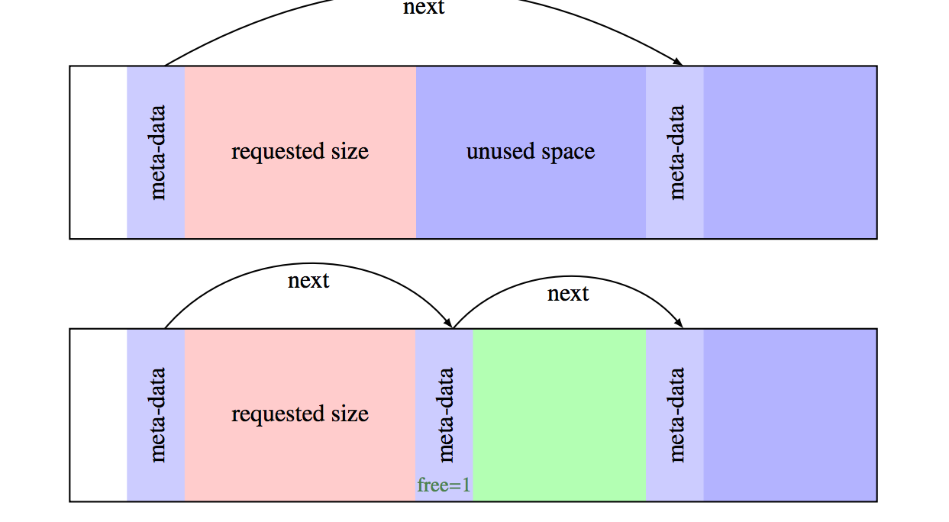
Splitting blocks, being smart with memory management

